Slide 1
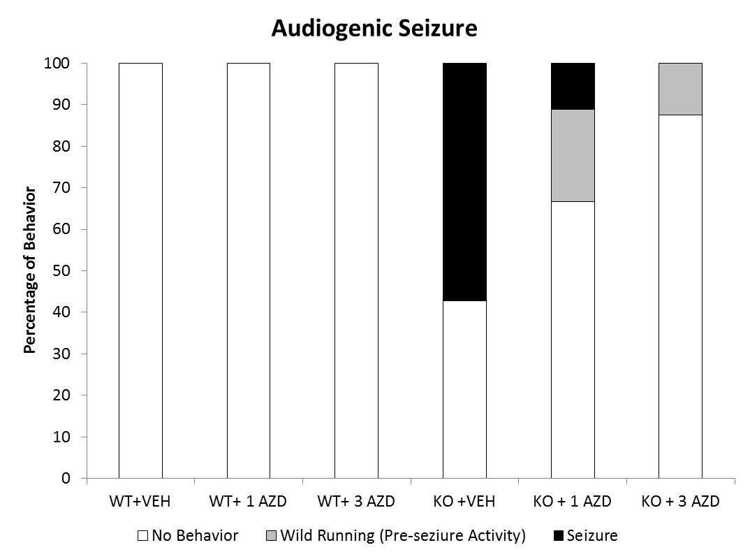
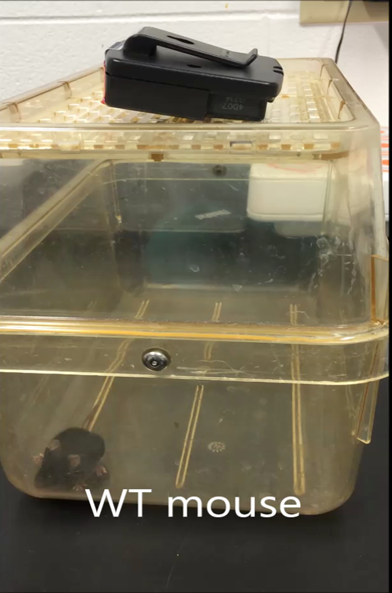
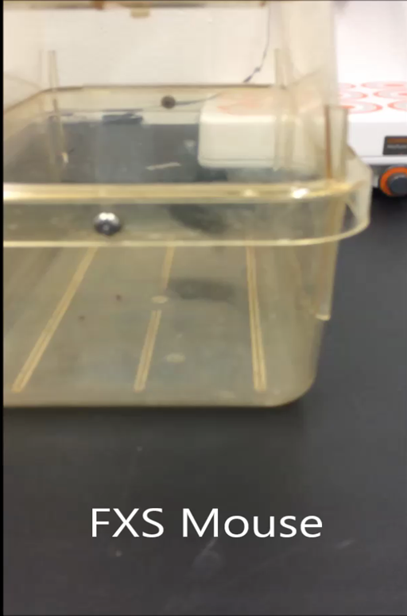
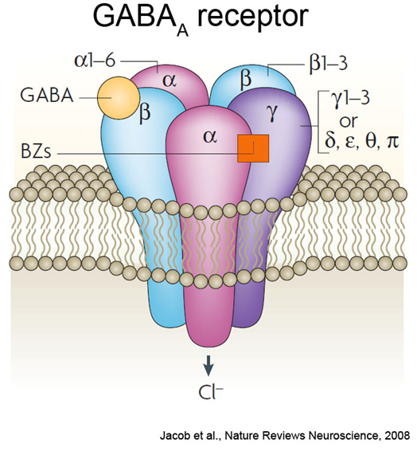

Reduced Audiogenic Seizure Susceptibility in a Mouse Model of Fragile X Syndrome via GABA(A) and ERK Modulation
Mohamed H. Elzarka, Amy A. Ashworth, Matthew H. Davenport, Melinda Stegman, Craig A. Erickson, Tori L. Schaefer
Cincinnati Children’s Research Foundation, Cincinnati, OH 45229 USA
Introduction
Results
Fragile X Syndrome (FXS) is a genetic disorder that results in a number of developmental disabilities including delayed language development and a high occurrence of moderate intellectual disability [1]. Common symptoms also include increased activity, severe anxiety, and hypersensitivity to sensory stimuli. In addition, about two-thirds of affected individuals display features consistent with autism spectrum disorder [1]. FXS occurs as a result of a silenced fragile X mental retardation 1 gene (Fmr1) and subsequent loss of fragile X mental retardation protein (FMRP) expression [1,2]. FMRP is an mRNA binding protein and plays a critical role at synapses to regulate activity-dependent protein translation. Loss of FMRP alters excitatory/inhibitory signaling balance [2].
A
B
The GABA(A) receptor is an ionotropic, ligand-gated ion channel composed of 5 subunits [3]. The endogenous ligand for this receptor is γ-aminobutyric acid (GABA), a major inhibitory neurotransmitter. When GABA binds the receptor, chlorine ions are selectively conducted through the pore, resulting in hyperpolarization of the
Figure 1: AZD7325 treatment augmented hyper- and hypo- responsiveness to acoustic stimuli in Fmr1 KO mice. (A) In low acoustic startle stimulus trials, KO+VEH-treated mice over-responded while low dose AZD7325 KO treated mice flinched similarly to WT+VEH-treated mice. (Two-way ANOVA; main effect of gene and drug, P<0.001 (both)). (B) Following high acoustic stimuli, Fmr1 KO mice under-respond with both treatment levels of AZD7325 improving startle reactivity above Fmr1 KO levels but not to the level of WT+VEH mice. (Two-way ANOVA; gene by drug interaction, P<0.001. Slice effects shown *P < 0.05 vs. WT+VEH; #P < 0.05 vs. KO+VEH. N = 16-18 per group
Figure 4: Acute AZD7325 treatment dose dependently reduces seizure susceptibility in P21 Fmr1 KO mice. Fmr1 KO mice are susceptible to wild running followed by tonic/clonic seizure and cardiac arrest (55%) during an audiogenic seizure (AGS) test. Fmr1 KO mice treated with AZD7325 have reduced seizure susceptibility and die less often than VEH-treated KO mice. Pictured are a WT mouse exhibiting no abnormal behavior and a FXS mouse exhibiting the wild running behavior that is indicative of pre-seizure activity during the AGS test.
neuron. This in turn leads to a diminished ability to fire a successful action potential and results in reduced neuronal activity.
In FXS, a decreased number of adult GABA(A) receptor mRNA units leads to a reduction in adult protein levels [4]. In addition, FXS patients have deficits in GABA(A) receptors that are localized outside of the synapse and responsible for basal long-term inhibition known as tonic inhibition [5].
Benzodiazepines are able to enhance ligand binding to the GABA(A) receptor through allosteric activation. This class of drug, however, is non-selective in binding to the different subunits that can comprise the receptor. This means that in addition to the anxiolytic effects attributed to modulation at α2 and α3, cognitive dulling (α5) and sedative effects (α1) are common. A new drug, AZD7325, works as a partial GABA(A) agonist specifically at the α2 and α3 subunits of the receptor and in this way works to limit the negative side effects associated with broad benzodiazepine use.
In addition, extracellular signal-related kinase (ERK) activation dynamics are altered in FXS and modulated by AZD7325 treatment in the hippocampus, a region important for sensory response, cognition, and seizure behavior. This type of mitogen-activated protein (MAP) kinase mediates transmission of signals from cell surface receptors to cytoplasmic and nuclear effectors. Efforts to better characterize the role of ERK activation in FXS etiology and the AZD7325 treatment response are ongoing.
A
B
#
Figure 2: (Preliminary) Increased cued fear conditioning was attenuated by treatment with AZD7325 in Fmr1 KO mice. KO+VEH-treated mice froze significantly more in response to a presented tone that had been previously associated with a mild foot-shock. Treatment with both doses of AZD7325 reduced freezing behavior to WT levels. Gene x Drug interaction P<0.003. N = 5 per group. Slice effects shown *P < 0.05 vs. WT+VEH; #P < 0.05 vs. KO+VEH.
Figure 3: ERK1/2 activation. Fmr1 KO mice have an increase in ERK1/2 activation in the hippocampus. Levels of ERK total were unchanged in all groups (not shown). *P < 0.05; N = 6/group. In a previous study, acamprosate—a drug used to treat alcohol dependence—was found to have attenuated ERK activation. The drug is theorized to work by opening the chlorine ion channel without utilizing the GABA ligand as a cofactor. This assists alcohol-dependent patients with down-regulated GABA(A) receptors to minimize excitatory brain activity.
Figure 5: (Preliminary) ERK1/2 activation in the Dentate Gyrus of the Hippocampus. (A) Nuclear ERK activation within the dentate gyrus of the hippocampus was quantified following AGS test in mice receiving a single treatment. N=2-4 per group. (B) Knockout mice which seized may have lower ERK activation compared to KO mice which did not seize and all wild type mice. (C) Drug and behavior naïve (no AGS test) WT mice may have a higher number of cells expressing pERK than do drug and behavior naïve KO mice. More animals are being added to all groups prior to statistical analysis.
C
Methods
Conclusion
References
Animals and AZD7325 Treatment
Female mice heterozygous for the Fmr1 mutation were bred to WT males from the same supplier and strain (JAX labs; C57BL/6). Male offspring were used as subjects. Adult mice (2-4 months old) were treated via oral gavage, once per day with vehicle (SBECD; VEH), 1 mg/kg, or 3 mg/kg AZD7325 administered in a volume of 5 ml/kg. Test mice were treated for 10 days prior to the start of adult behavior testing and daily treatment continued until the mice were sacrificed. Mice were given 30 min. between injection and the start of each behavior test daily.
Acoustic Startle Habituation (Sensorimotor Processing)
Mice were placed in a sound attenuating chamber in a plastic holder fixed to a force transducer (SR San Diego Instruments, San Diego, CA). They were exposed to a series of startle burst trials with an inter-trial interval of 4-12 sec (80 and 120 dB). Startle response was measured in arbitrary units (Vmax).
Conditioned Fear (Cued Fear Memory)
Mice were subjected to 3 tone – shock pairings on day one. On day two (contextual) and three (cued; chamber visually altered; tone presented) mice were placed back in the chamber and freezing behavior was measured (Freeze Monitor San Diego Instruments, San Diego, CA).
Audiogenic Seizure Test (AGS)
Juvenile mice (postnatal day 21) were placed into an empty mouse cage following a single treatment 30 minutes prior. A clear Plexiglas lid containing a mini-personal alarm (SKU 49–728, RadioShack, Fort Worth, TX, USA) placed on top of the cage. Upon activation, the alarm emitted a 120 dB sound. The test protocol involved two presentations of the following: 1 min with no sound, followed by a two minute period with alarms on as a priming stimulus. Then there is another one minute acclimation in silence before the two minute test tone is presented. The presence of wilding running, seizure (defined as myoclonic/myotonic convulsions), and respiratory arrest were recorded.
ERK Activation
The mice used in the behavior experiments were sacrificed and hippocampus was dissected and used for ERK1/2 total and pERK1/2 quantification using an ELISA (Abcam). Juvenile mice were sacrificed just following AGS and additional adult mice were perfused, and then brains were sectioned and stained for pERK (Cell Signaling) using standard IHC methods.
Fmr1 KO mice have baseline behavior deficits in acoustic sensory reactivity, cued conditioned fear, novel object memory and seizure susceptibility.
Treatment with the low dose of AZD7325 improves these behaviors in Fmr1 KO mice while the high dose augments deficits in some tests, but not in others.
ERK1/2 activation is known to be altered under basal conditions in adult Fmr1 KO mice. However it is unknown if changes in pERK in young mutants of following behavioral stimulation such as following the AGS test are also altered. Our preliminary data suggest that ERK activation following treatment with AZD7325 may be playing a role in seizure resistance following an acute dose in young mice. More animals are needed to draw strong conclusions.
[1] Busquets-Garcia A, Maldonado R, Ozaita. New insights into the molecular pathophysiology of fragile X syndrome and therapeutic perspectives from the animal model. Int’l J BioCel 2014; 53, 121-126.
[2] Bardoni B, Davidovic L, Bensaid M, Khandjian EW. The fragile X syndrome: exploring its molecular basis and seeking a treatment. Expert Reviews in Molecular Medicine 2006, 8, 1-16.
[3] Stromgaard, K., Krogsgaard-Larsen, P., & Madsen, U. (2009). Textbook of Drug Design and Discovery, Fourth Edition .
[4] D'Hulst, C., De Geest, N., Reeve, S., Van Dam, D., De Deyn, P., Hassan, B., et al. (2006). Decreased expression of the GABAA receptor in fragile X syndrome. Brain Research, 238-245.
[5] Farrant, M., & Zoltan, N. (2005). Variations on an inhibitory theme: phasic and tonic activation of GABAA receptors. Nature Reviews Neuroscience, 215-229
Funded by The FRAXA Research Foundation and the National Fragile X Foundation
Notes:
Fragile X Syndrome (FXS) is a genetic disorder that results in a number of developmental disabilities including delayed language development and a high occurrence of moderate intellectual disability. Common symptoms also include increased activity, severe anxiety, and hypersensitivity to sensory stimuli. In addition, about two-thirds of affected individuals display features consistent with autism spectrum disorder. FXS occurs as a result of a silenced fragile X mental retardation 1 gene (Fmr1) and subsequent loss of fragile X mental retardation protein (FMRP) expression. FMRP is an mRNA binding protein and plays a critical role at synapses to regulate activity dependent protein translation. Loss of FMRP alters excitatory/inhibitory signaling balance. Decreases in gamma-aminobutyric acid (GABA)(A) receptor subunit expression as well as reductions in GABA have been reported in the hippocampus and amygdala leading to significant reductions in inhibitory control. Benzodiazepines can be used to boost inhibitory signaling and reduce anxiety, although the non-selective nature of this drug class results in undesirable side effects such as sedation and memory impairment. Recent studies have shown the GABA(A)α2 and α3 subunits to be responsible for the anxiety reducing effects of traditional benzodiazepines. AZD7325 is a partial GABA(A) agonist specific for the α2 and α3 subunits. The current study seeks to improve behavioral disruption in the mouse model of FXS by increasing GABA(A)α2,3 receptor activity with AZD7325 treatment. Results show that drug treatment greatly reduces the occurrence of audiogenic seizure susceptibility and acoustic startle reactivity while improving memory. In addition, extracellular signal-related kinase (ERK) activation dynamics are altered in FXS and modulated by AZD7325 treatment in several brain regions important for sensory response and seizure behavior. Efforts to better characterize the role ERK activation plays in FXS etiology and AZD7325 treatment response are ongoing.
ERK is involved in neural and synaptic plasticity underlying learning and memory and sensory hypersensativity
Activation is required for consolidation of fear memory
Drug seeking in response to a conditioned stimulus is increased with increased ERK1/2 activation
Extinction of conditioned response is dependent on ERK dephosphorylation
GABA(A) activity may regulate ERK activation

